Slide 1
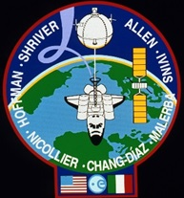
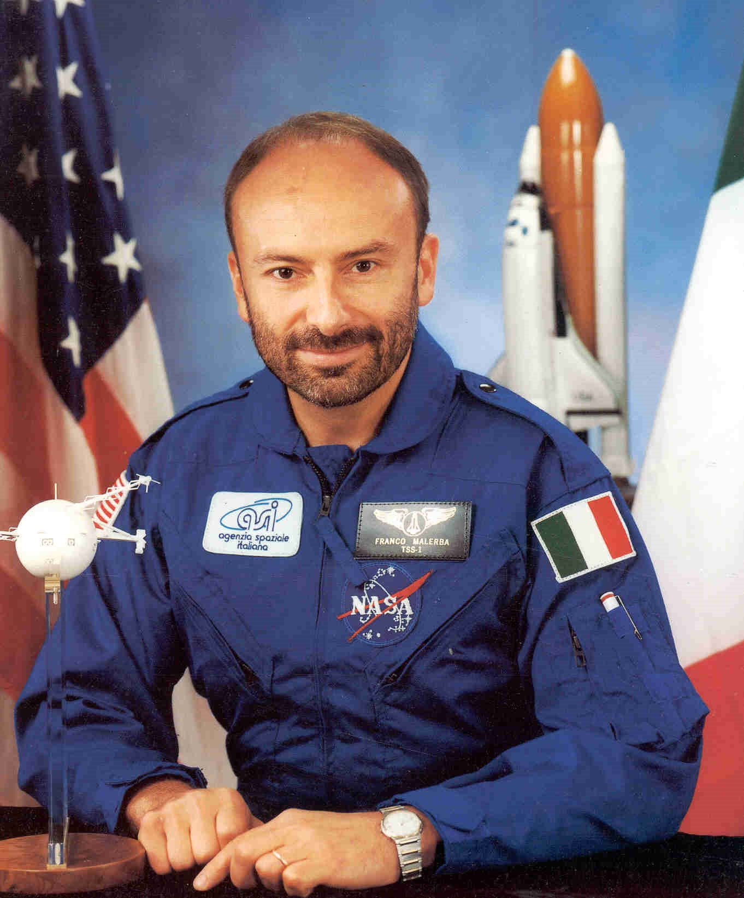
31st July 1992, Shuttle Atlantis – STS 46 Mission Franco Malerba PS1 - 248th space explorer

Slide 2
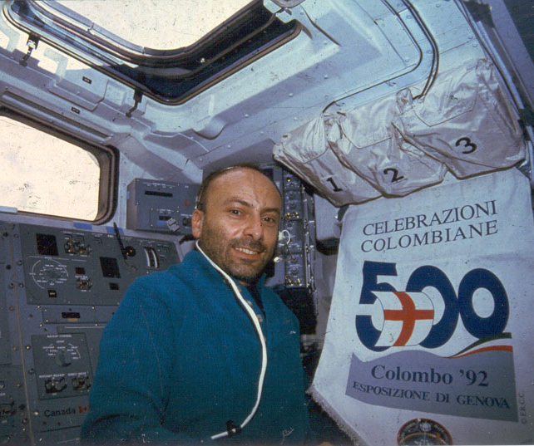

Slide 3
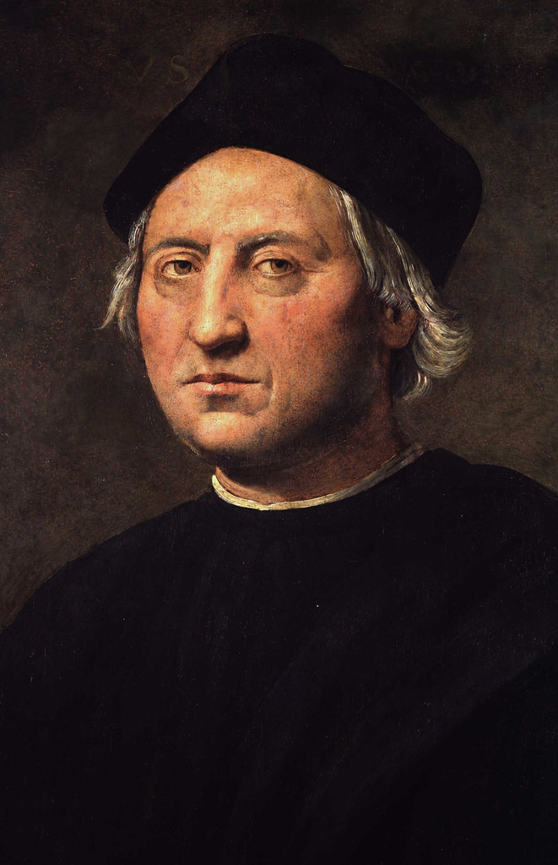
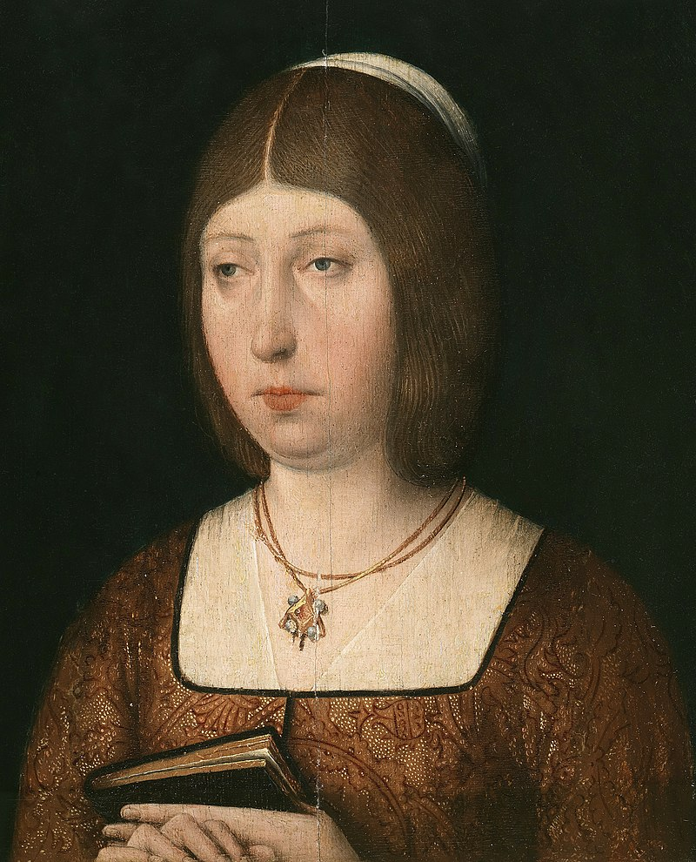
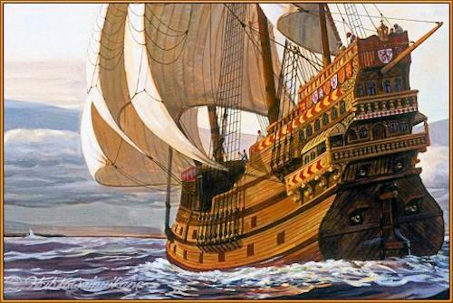
A new route to the Indies?
The discovery of a new continent.
Christopher Columbus
Isabella I of Castile

Slide 4
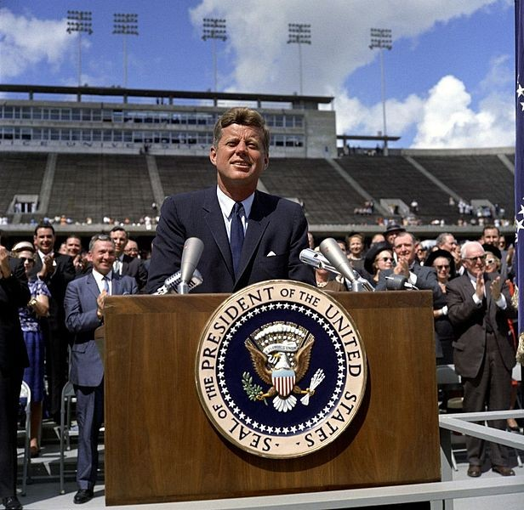
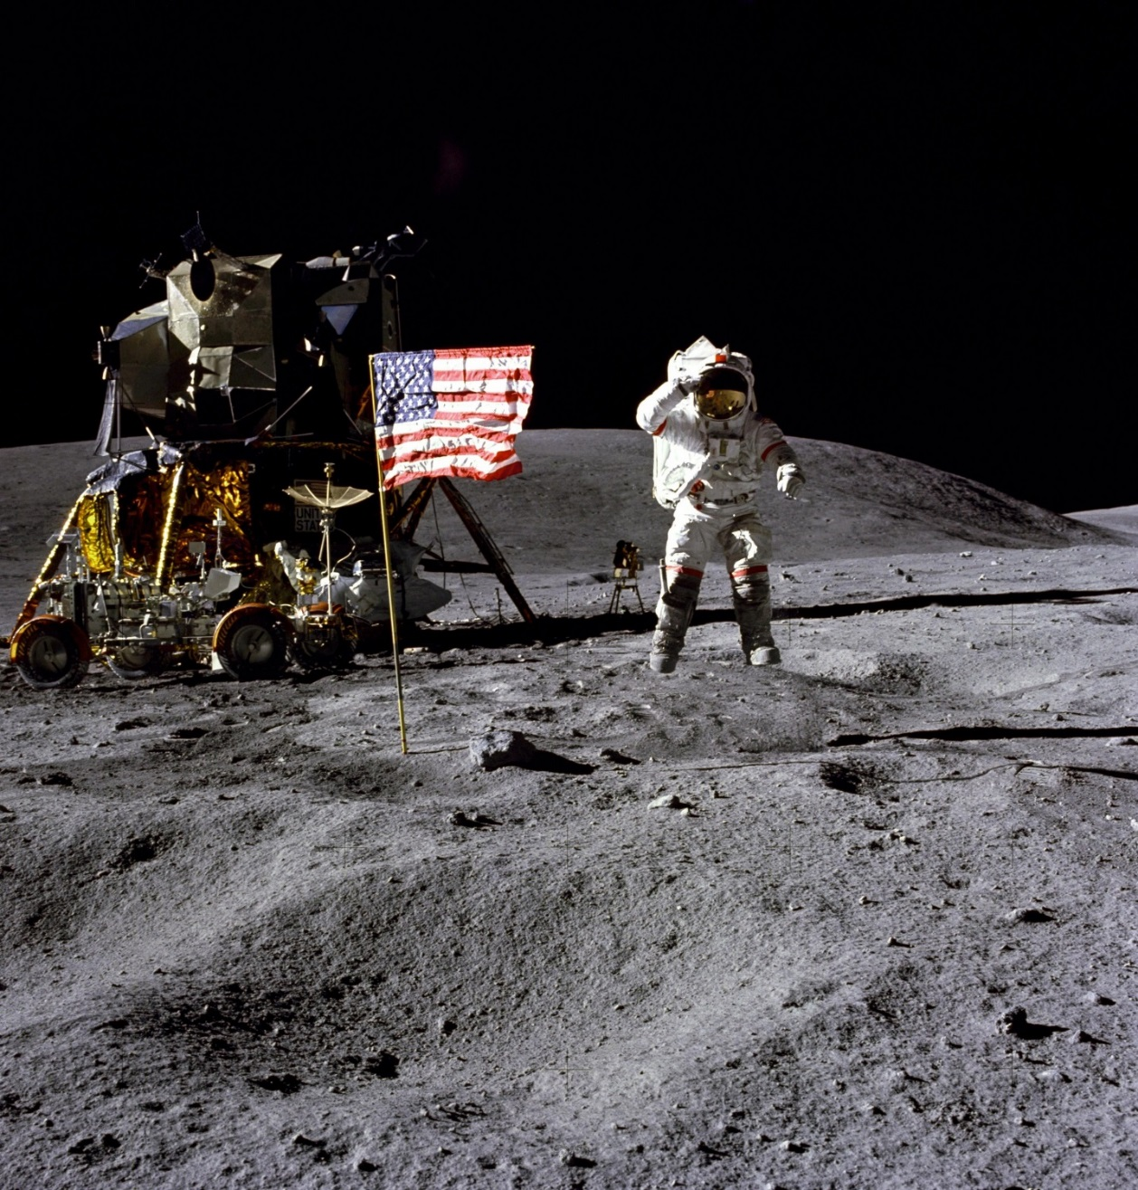
20th July 1969: the first man on the Moon
“We choose to go to the Moon, and do the other things, not because they are easy, but because they are hard”
September 12, 1962,

Slide 5
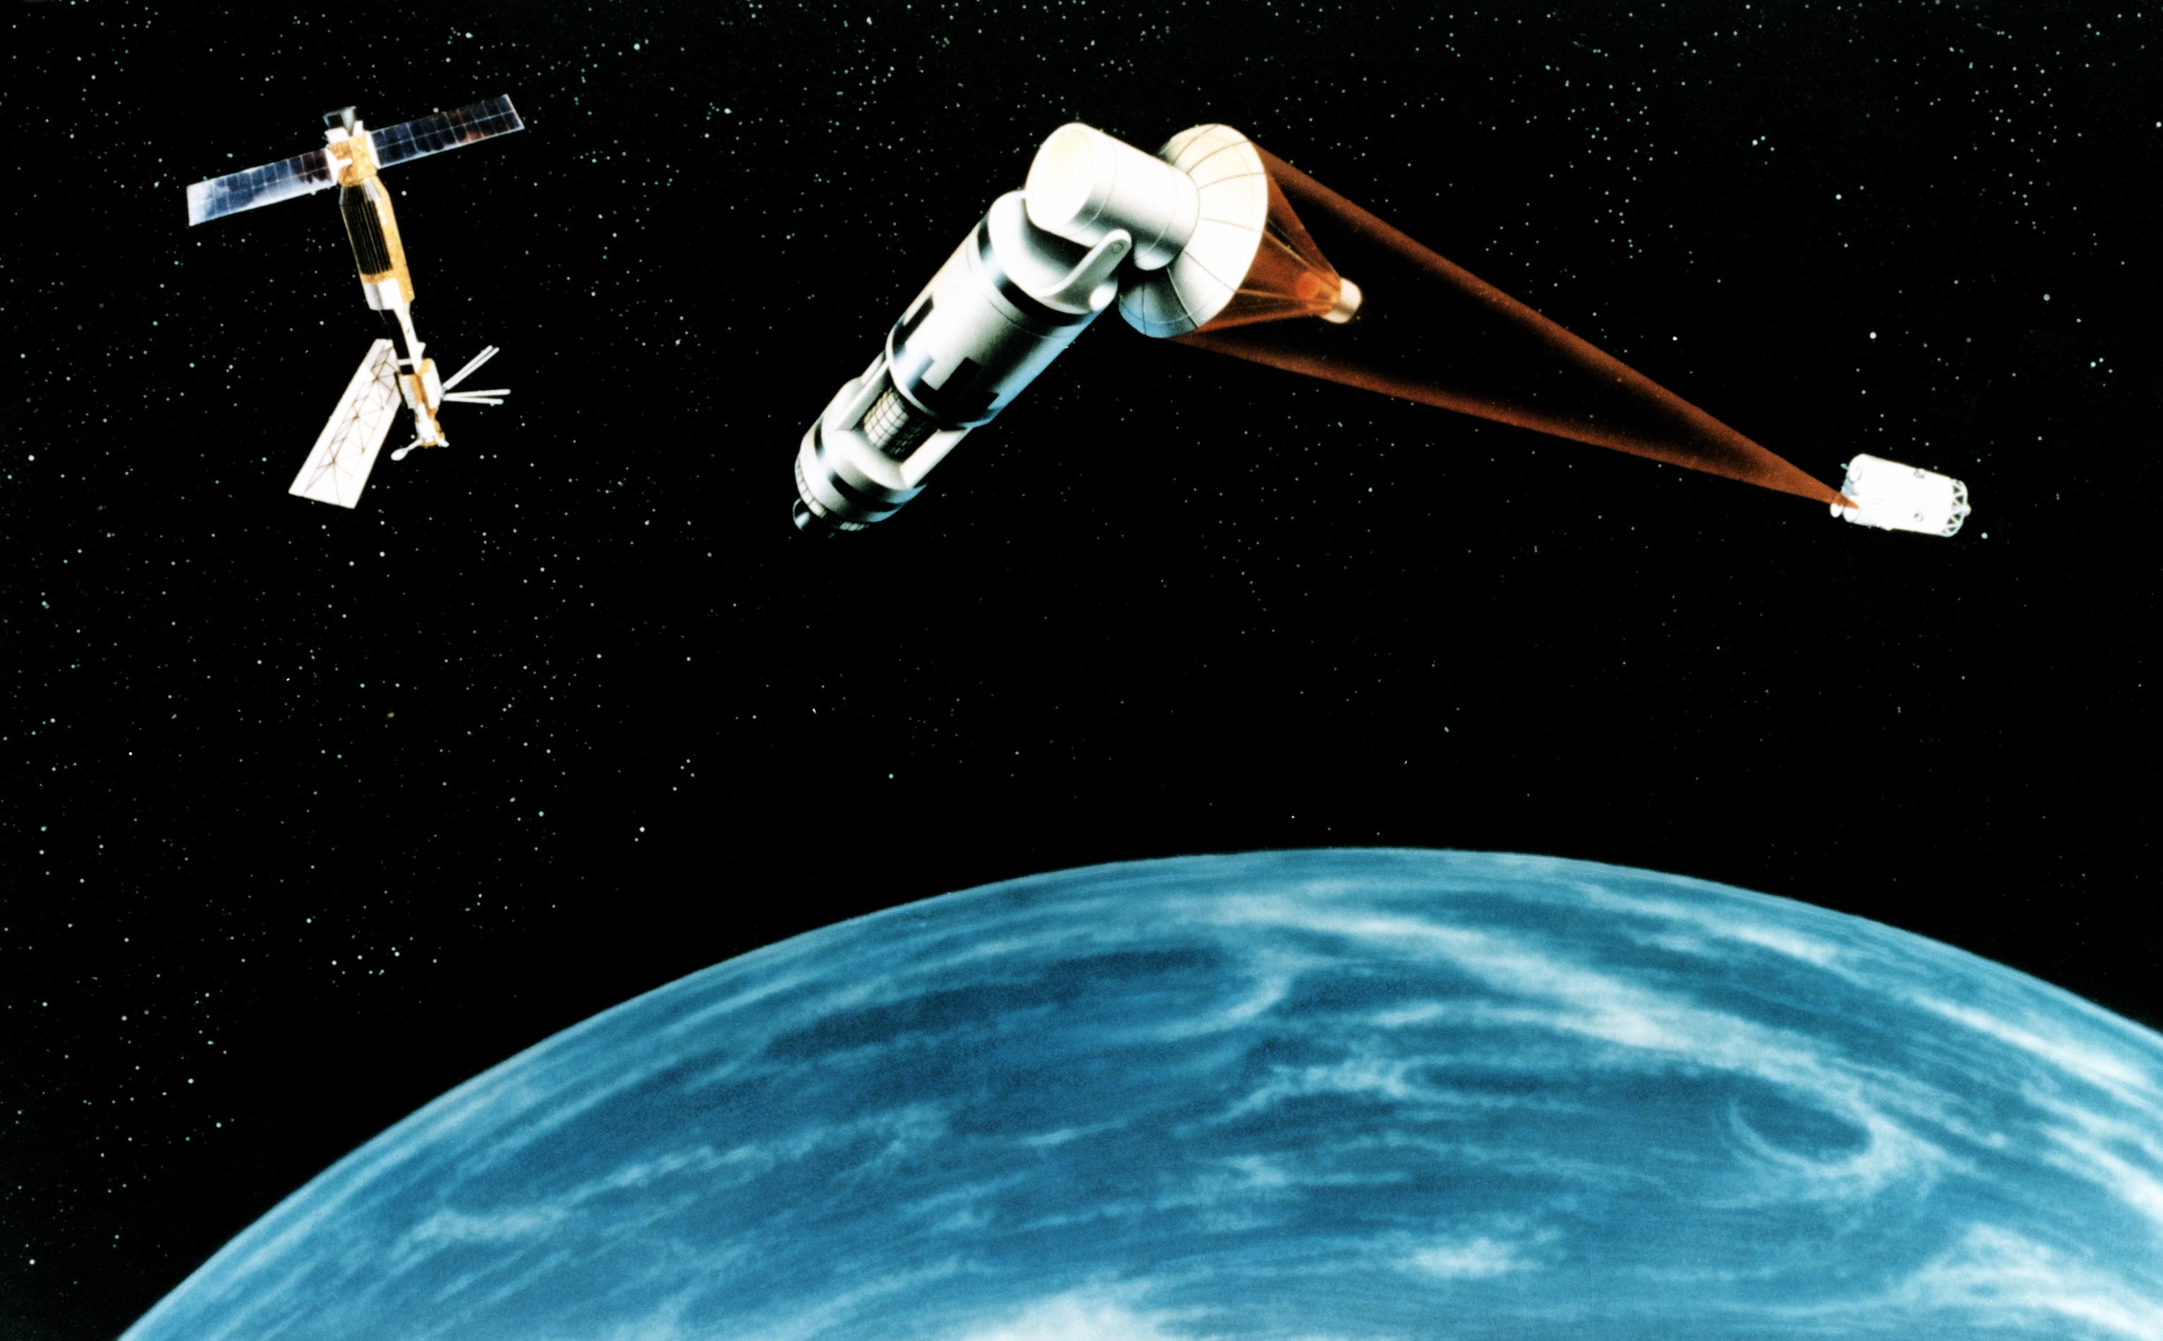
1983: launch of the the Strategic Defense initiative
1984: launch of the Space Station Freedom
SDI: Laser weapons operating from space

Slide 6
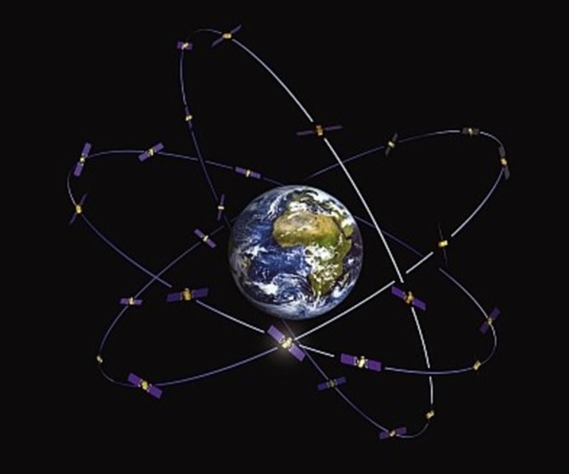
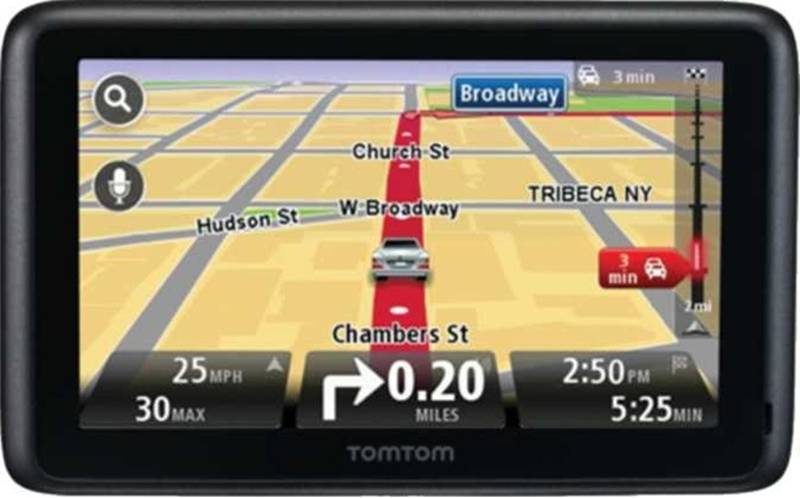
The Global Positioning System (GPS) is born

Slide 7
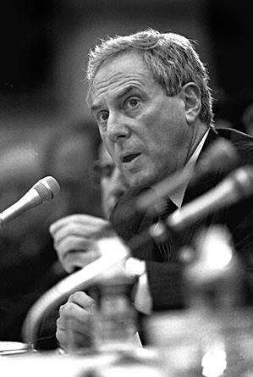
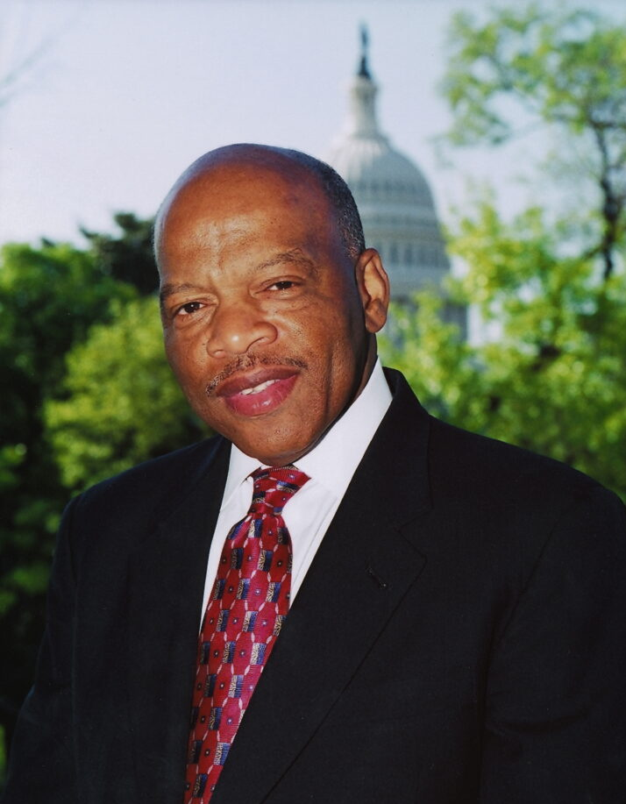
Dan Goldin, NASA Administrator
and Hon. John Lewis
salvaged the ISS in 1994

Slide 8
When an American family runs into tough times, they do not take funds from their children’s education, they cut out unnecessary spending.
Cutting the station would be tantamount to taking money from a child’s education fund to continue to eat dinner out every night.
……We became great by dreaming and pursuing that dream. As soon as we lose the ability to dream and reach for the stars we cease to be great.
Hon. John Lewis

Slide 9
2000:
The New space economy begins
By the policies of the Obama administration.
«the Government must not interfere with US innovation»
(Space commercialization Act)
By the initiative of some visionary American entrepreneurs
By the great availability of Venture Capital in the US market.

Slide 10
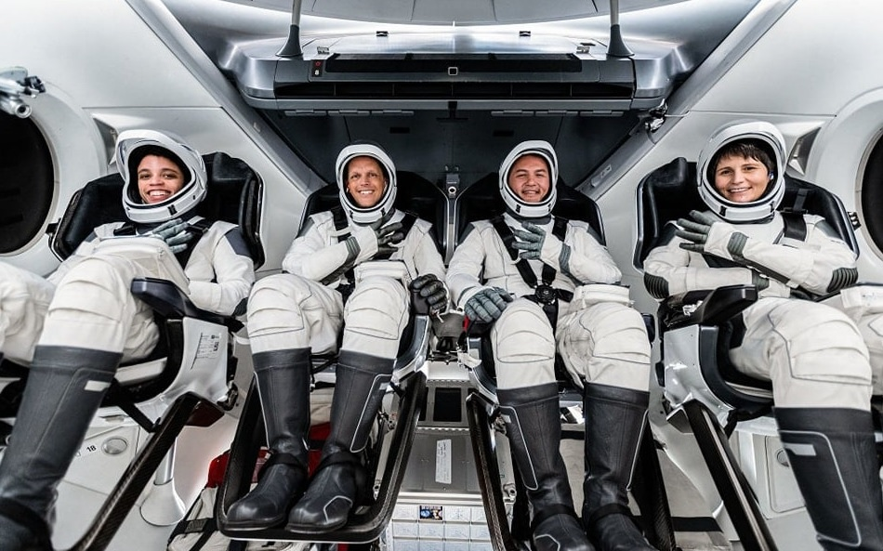
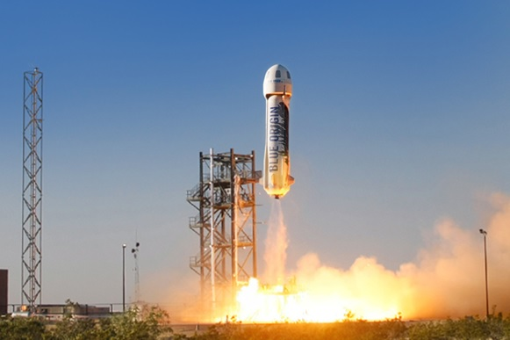
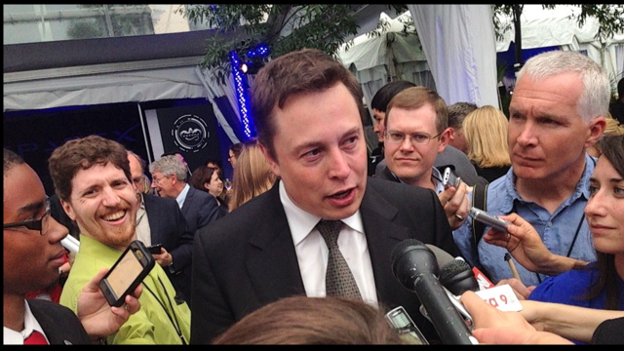

Slide 11
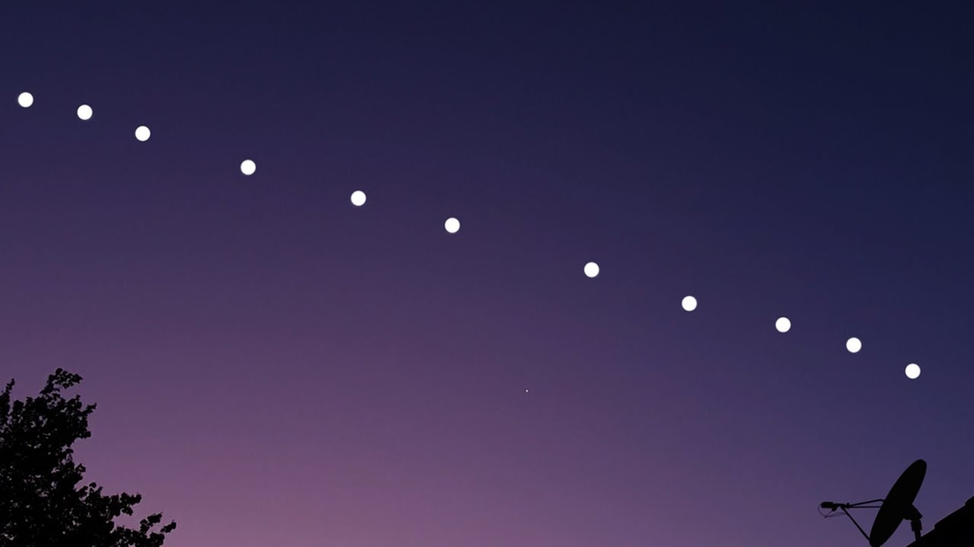
«The constellations of satellites in low orbits
can replace terrestrial networks»

Slide 12
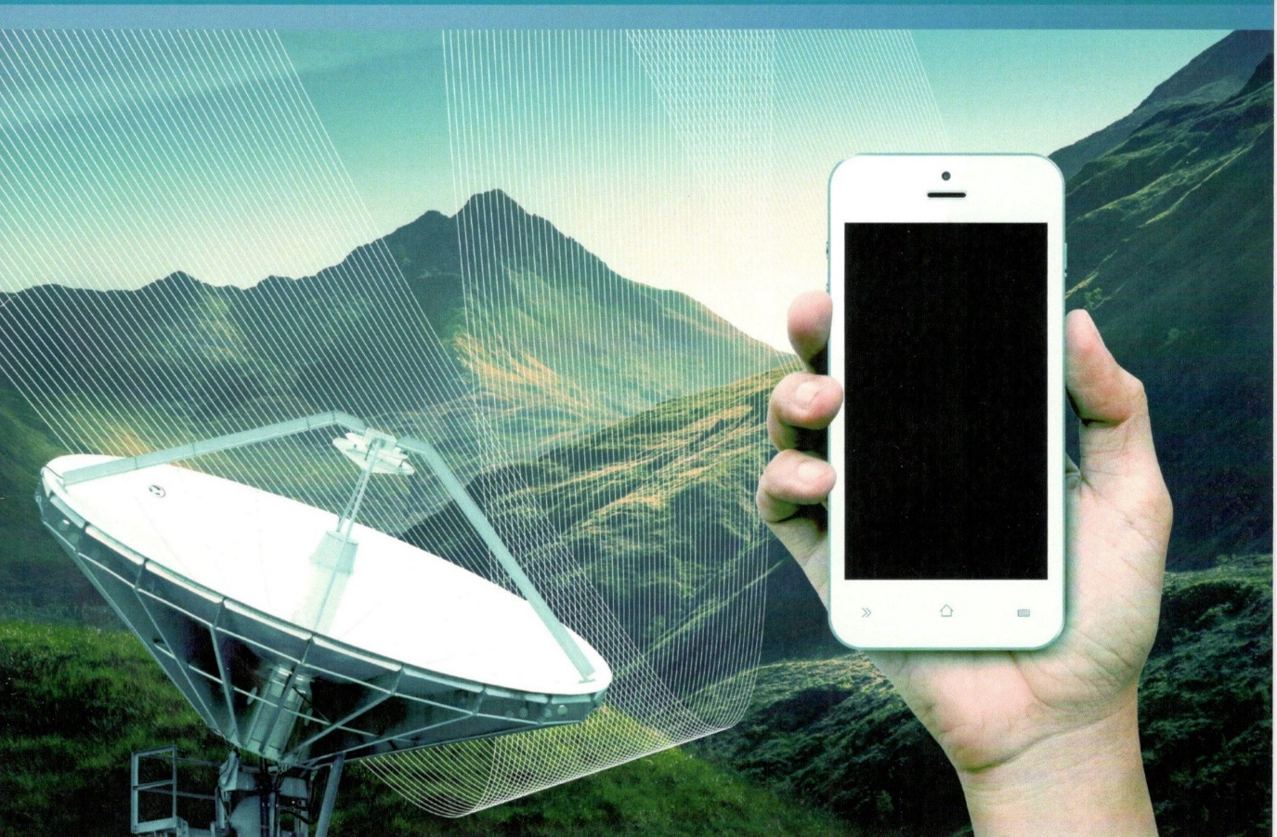
La «explosive mixture»: space + digital
SMARTPHONE: the world … in your pocket
Notes:
U

Slide 13
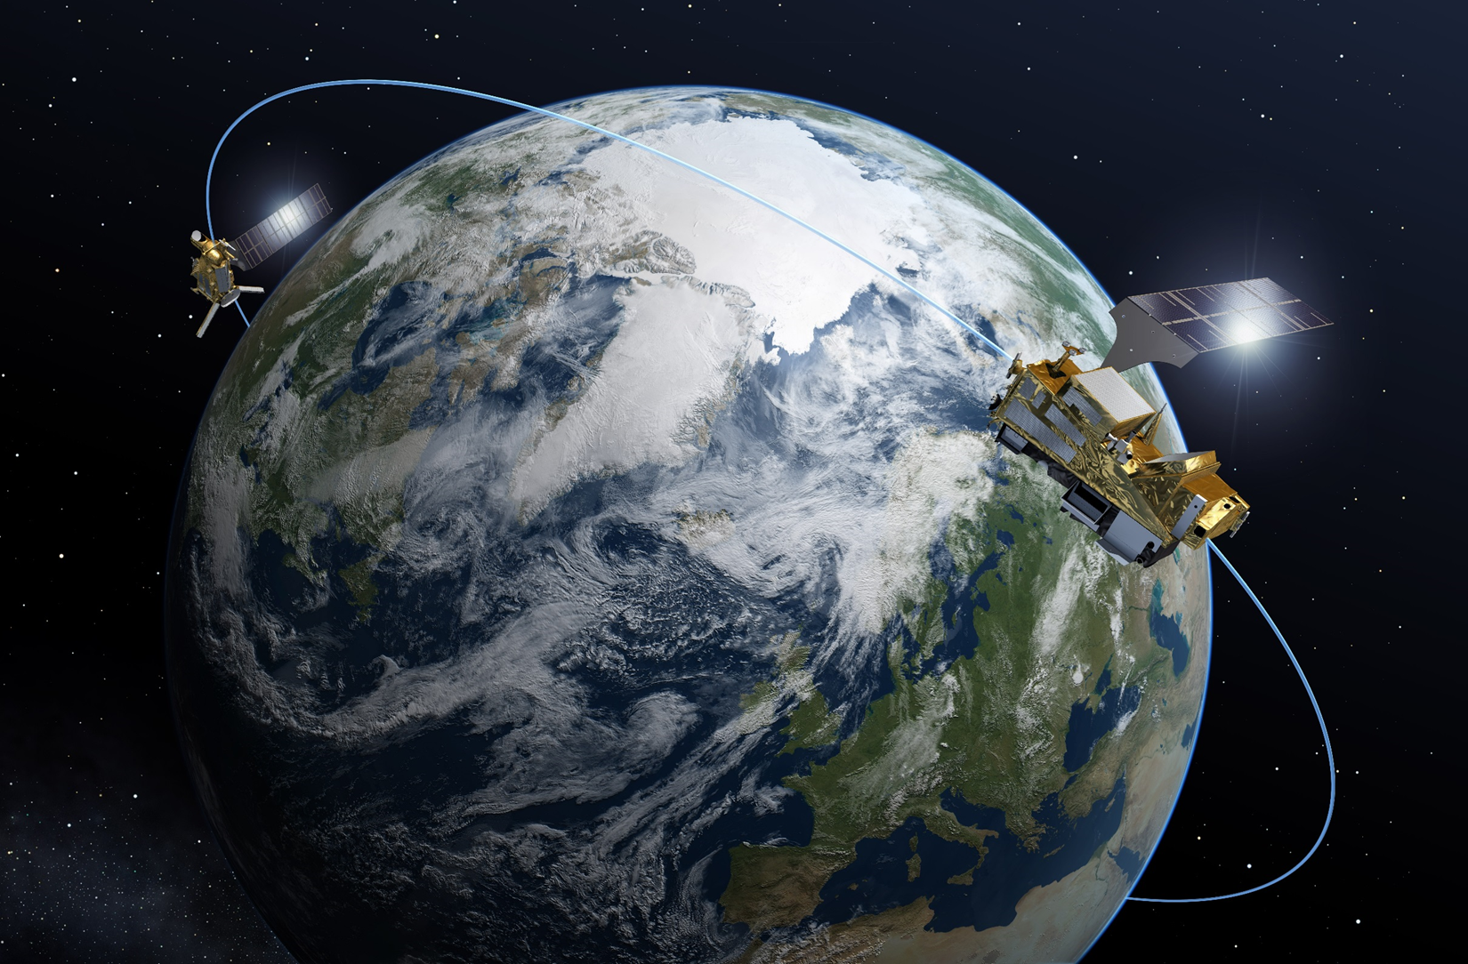
From data to information
Telescope
Macroscope

Slide 14
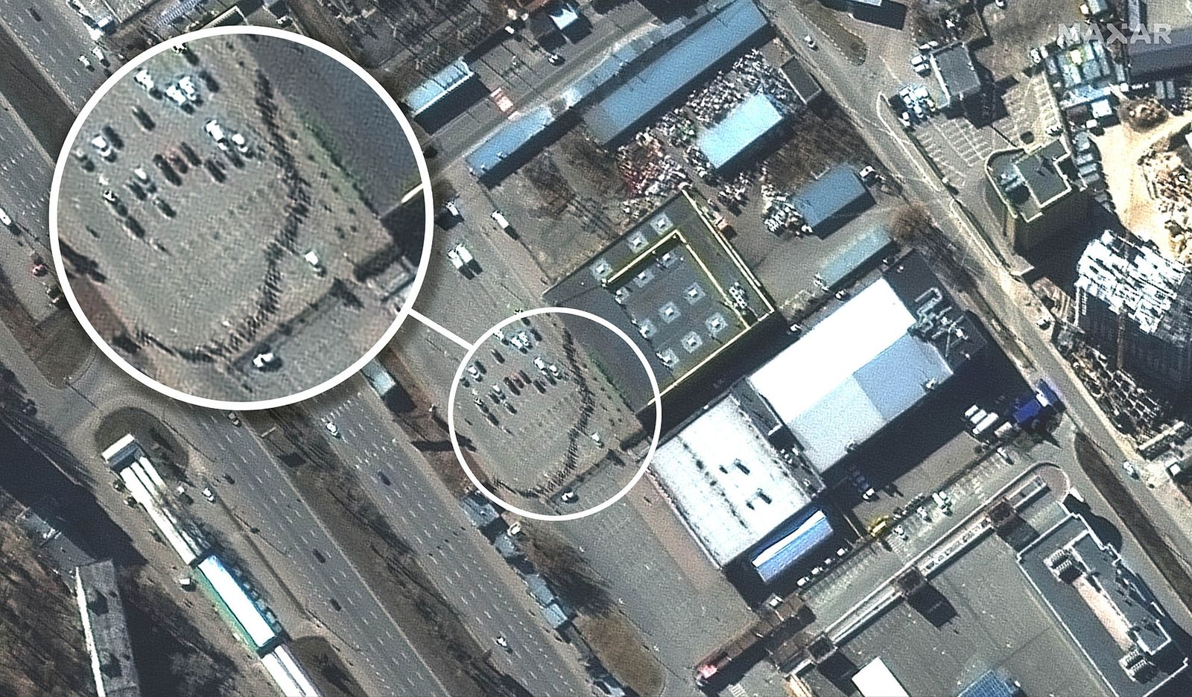

Slide 15
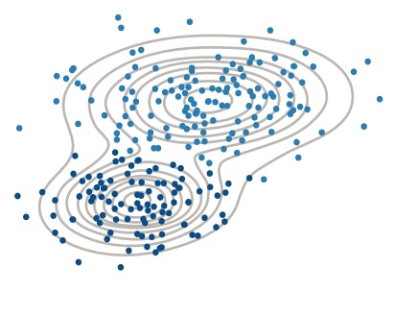
New math algoritms
High performance computing
Machine learning
Artificial intelligence
Neural Networks

Slide 16
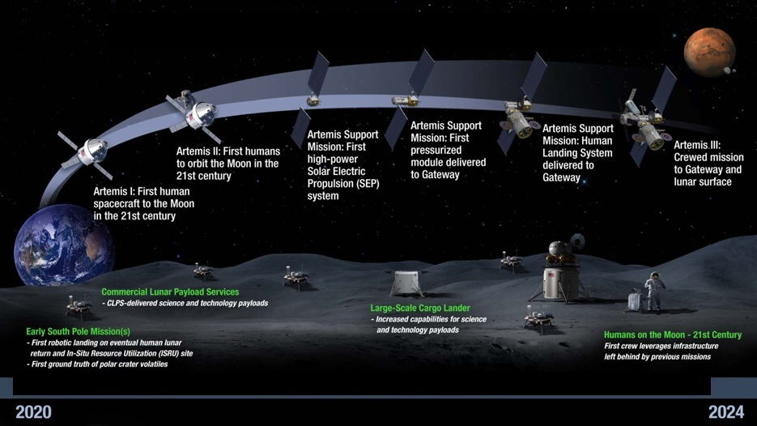
2017: launch of the Artemis program, return to the Moon «to stay»

Slide 17
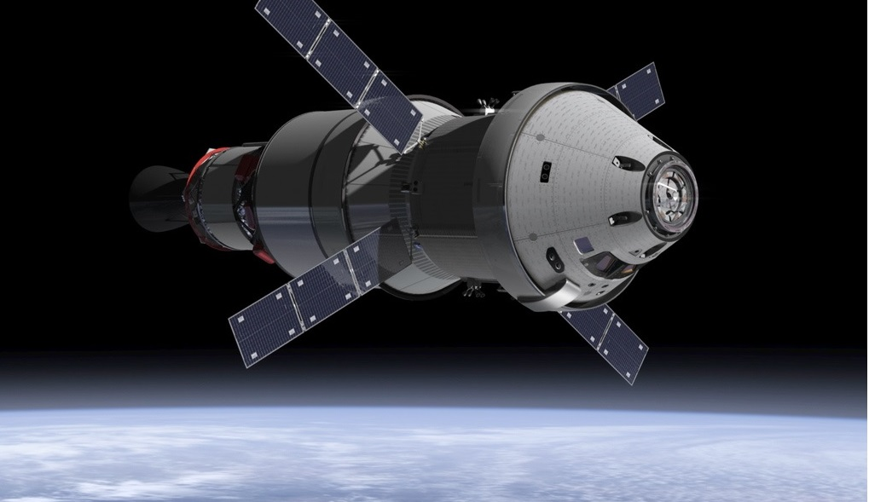
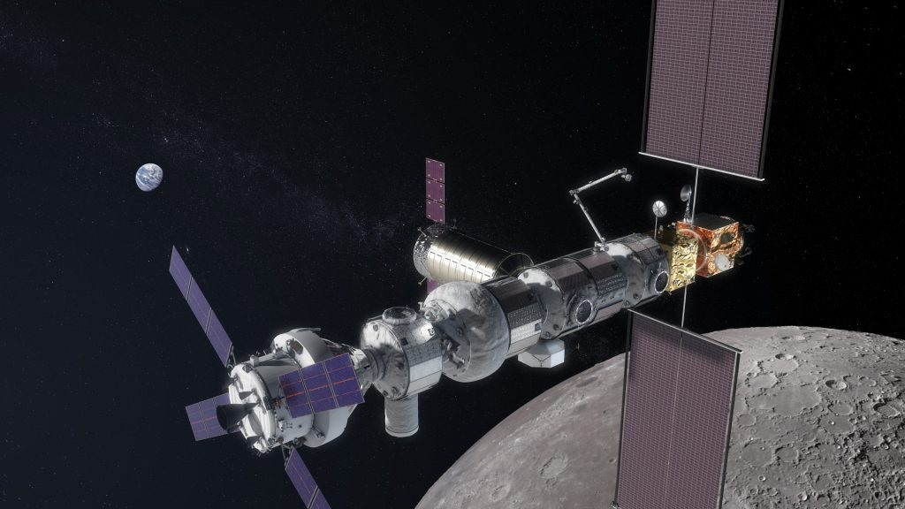
The Artemis Moon missions elements are in development
Transport: ORION, ICGM, SLS
Gateway: PPE, HALO, IHAB, Airlock…
Landers: Starship, Argonaut ..

Slide 18
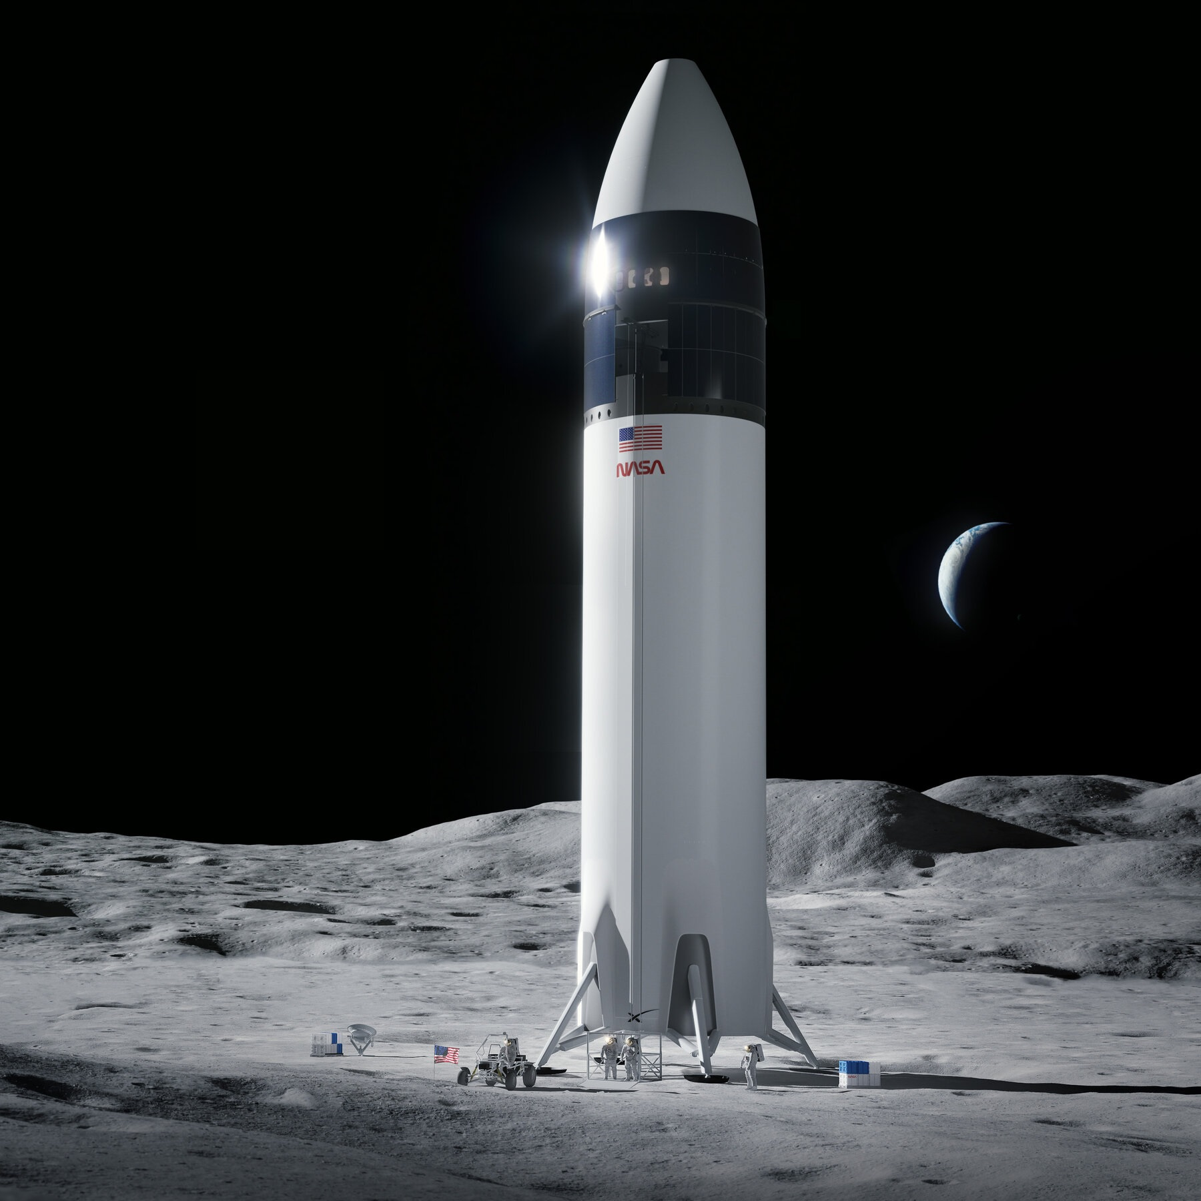
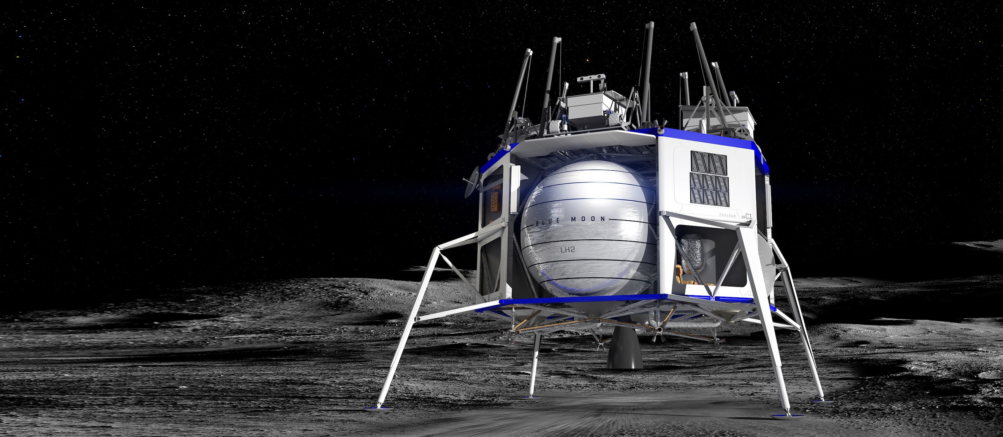
The Moon landers …
SpaceX
Blue Origin
ESA’s Argonaut

Slide 19
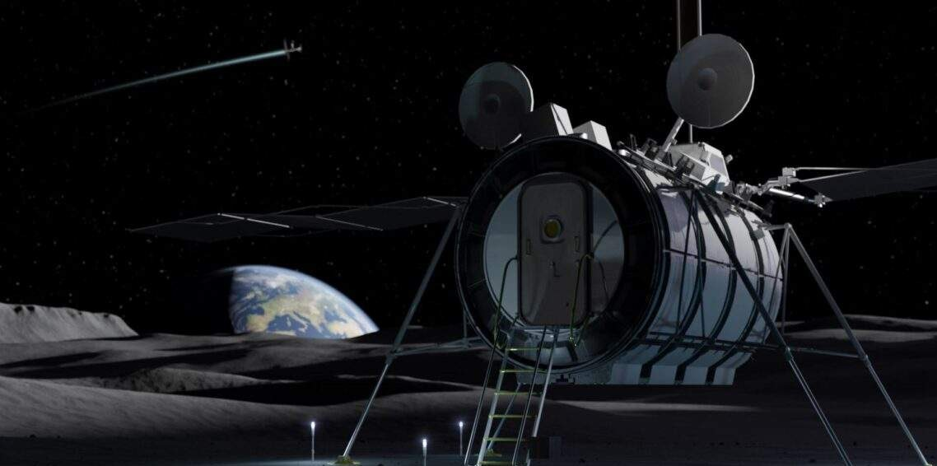
MPH – Multipurpose Logistic Module on the Lunar surface by ASI

Slide 20
2007: with the Lisbon Treaty
The UE acquires the competency
in the field of space
2021:The von der Leyen Commission (2020) establishes the Space and Defense Directorate
under Commissioner Thierry Breton
EUSPA Agency is born:
«Space Policy Agency»

Slide 21
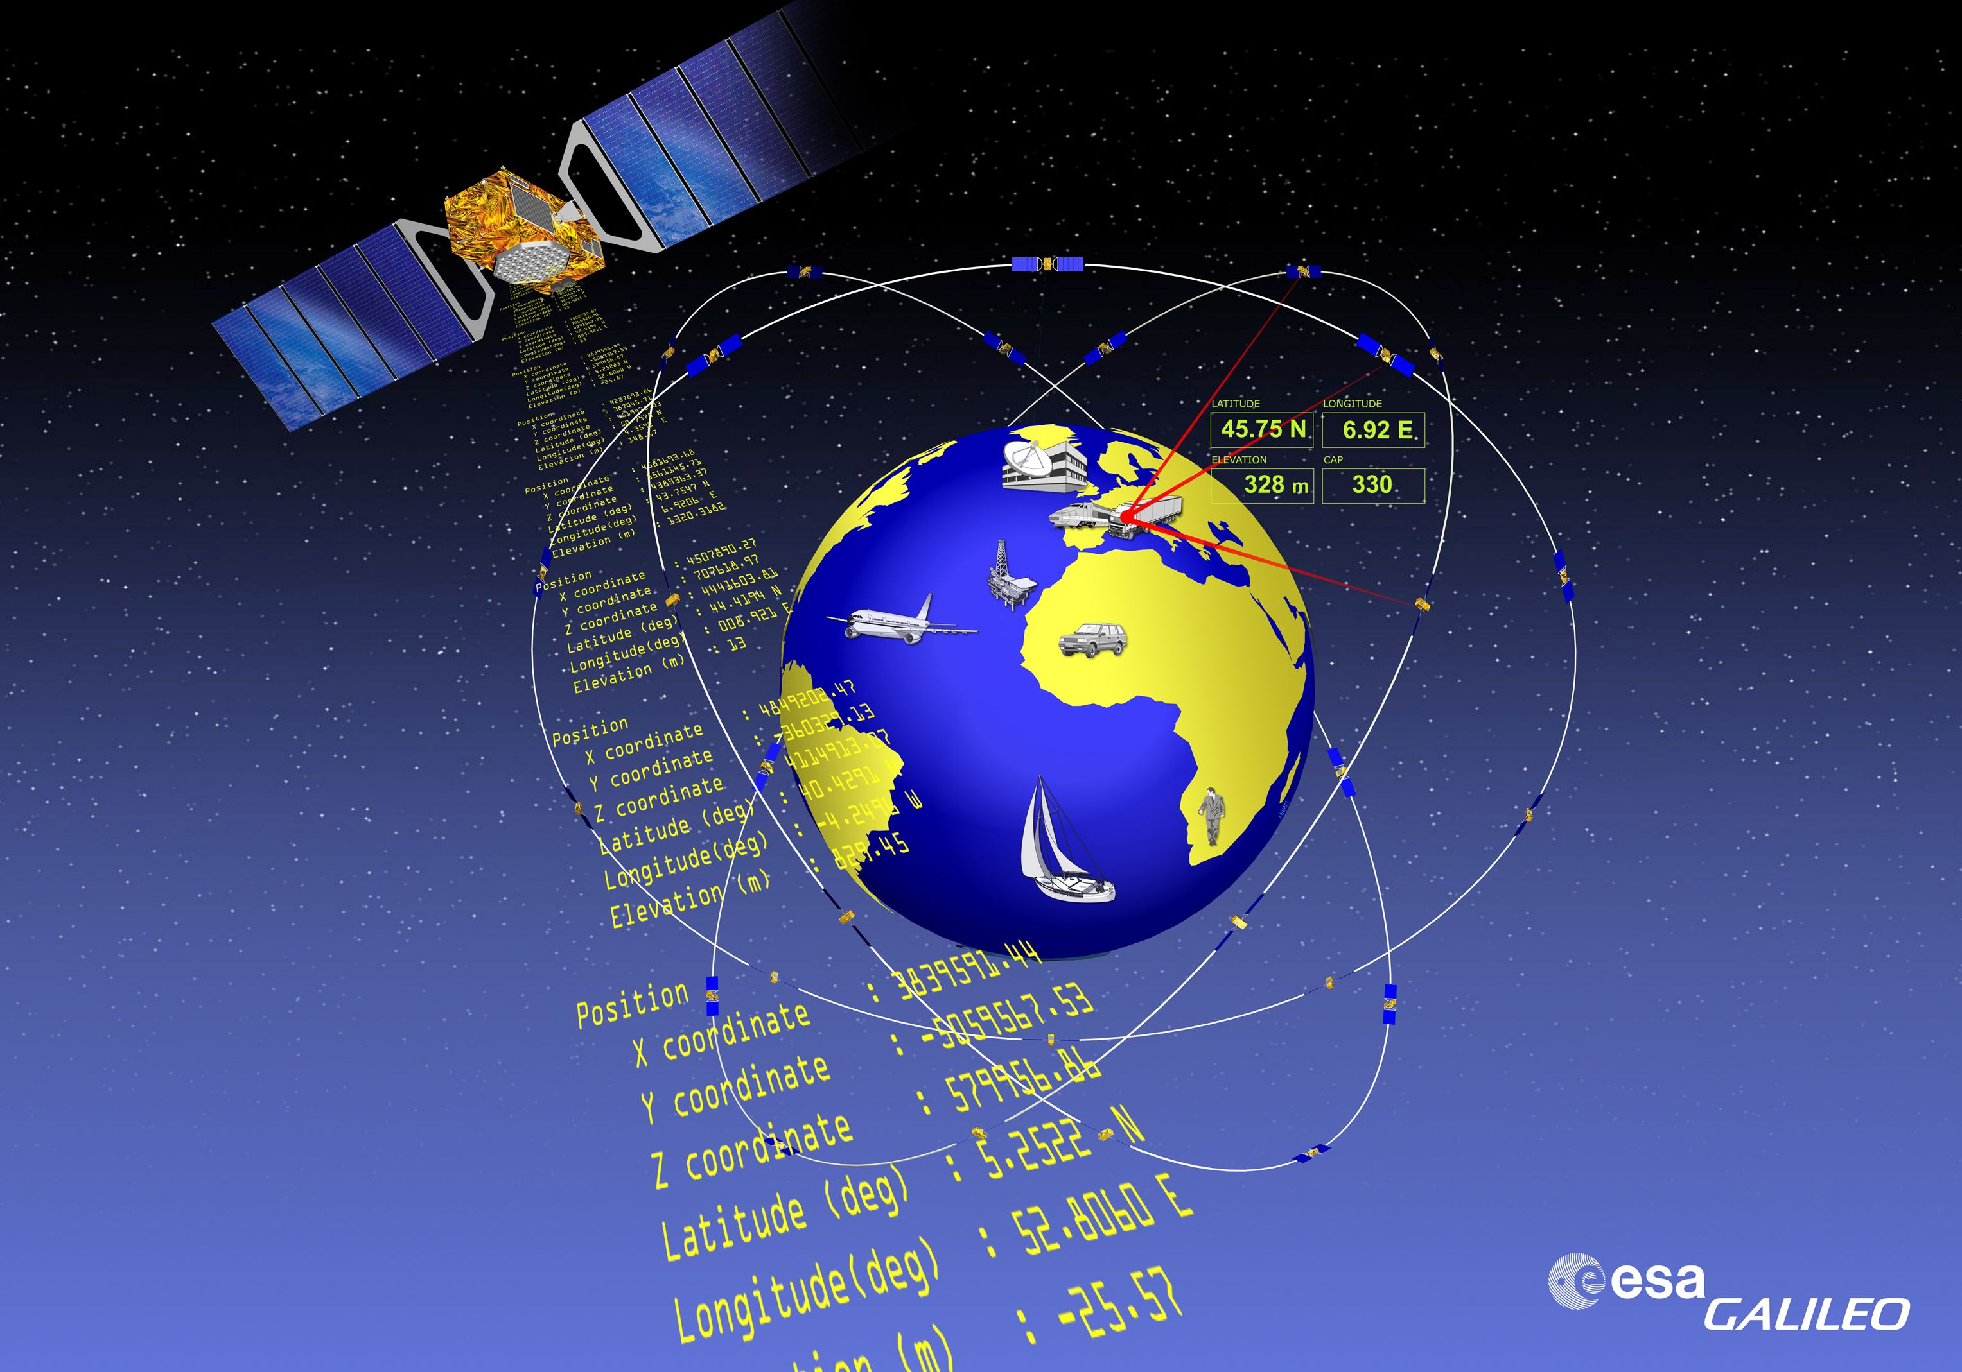
Today : Galileo, the European Navigation system

Slide 22
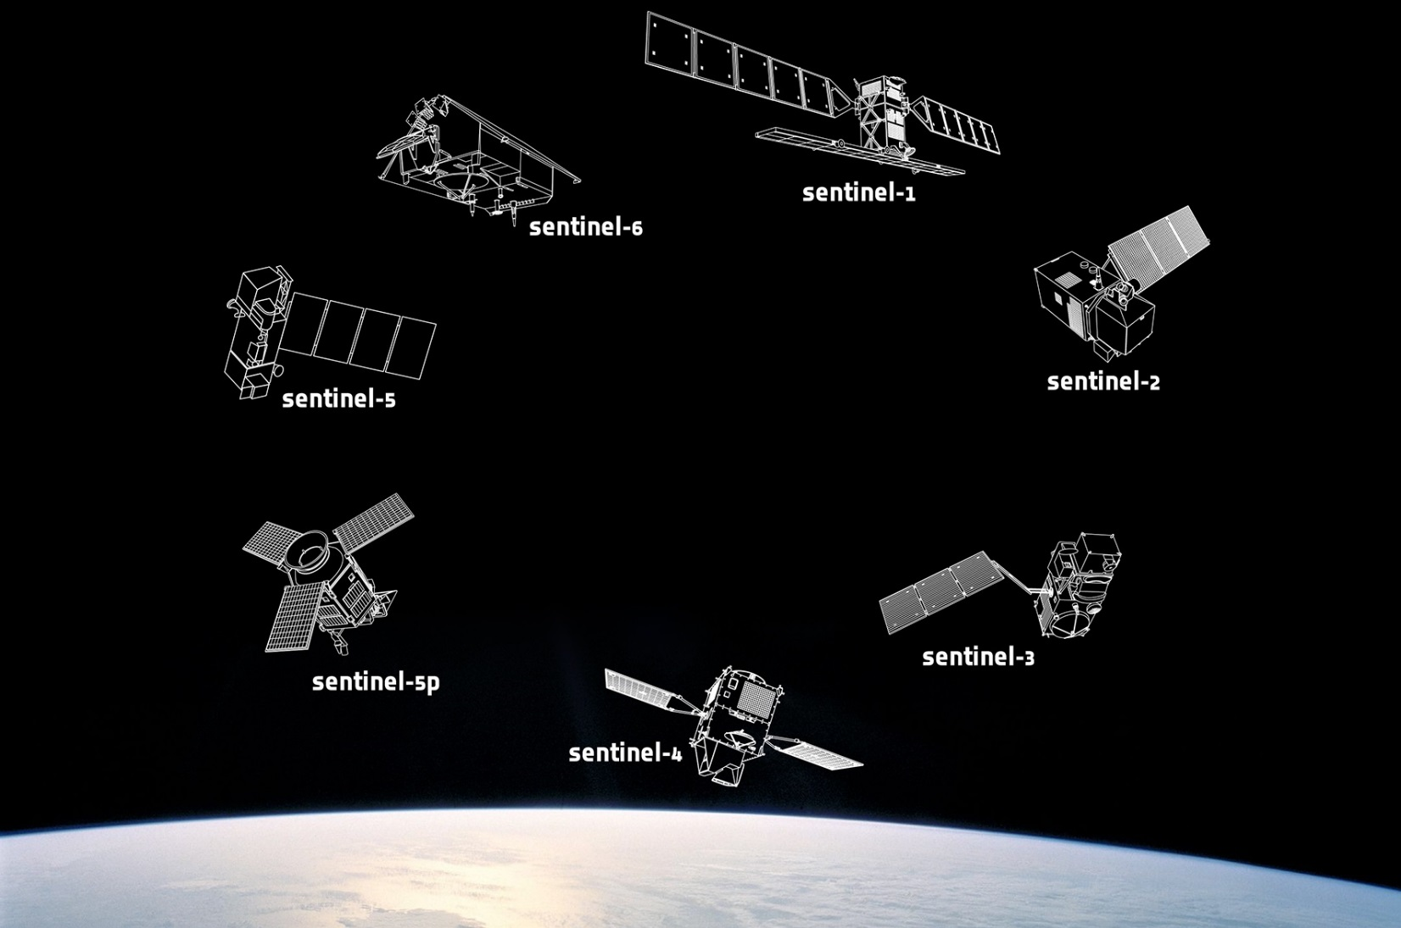
Copernicus: the evolutionary European system of Earth Observation

Slide 23
IRIS2: the future European cyber-resilient satellite communications network

Slide 24
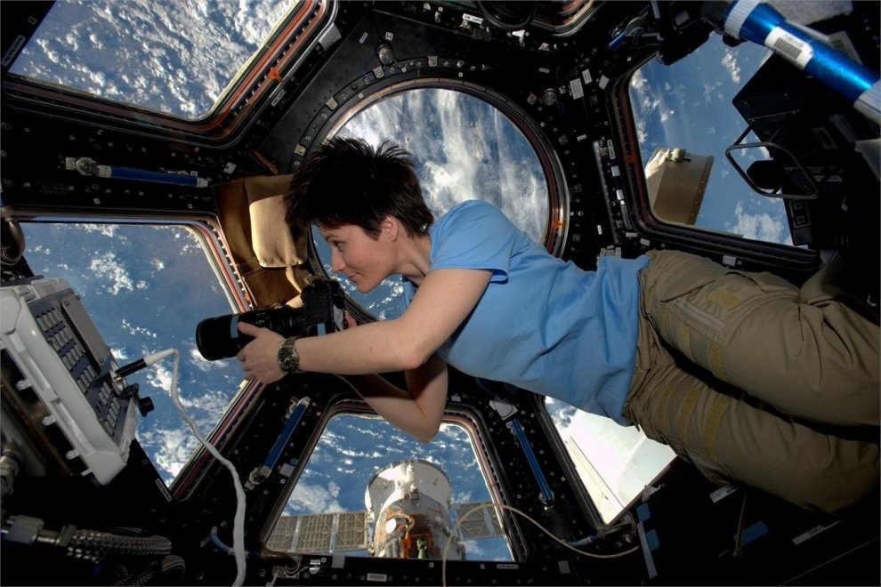
The ISS: Learning about living and working in Space.
There is something about space that touches even people who are not interested in science
The International Space Station will close for business 2030; what will happen next?

Slide 25
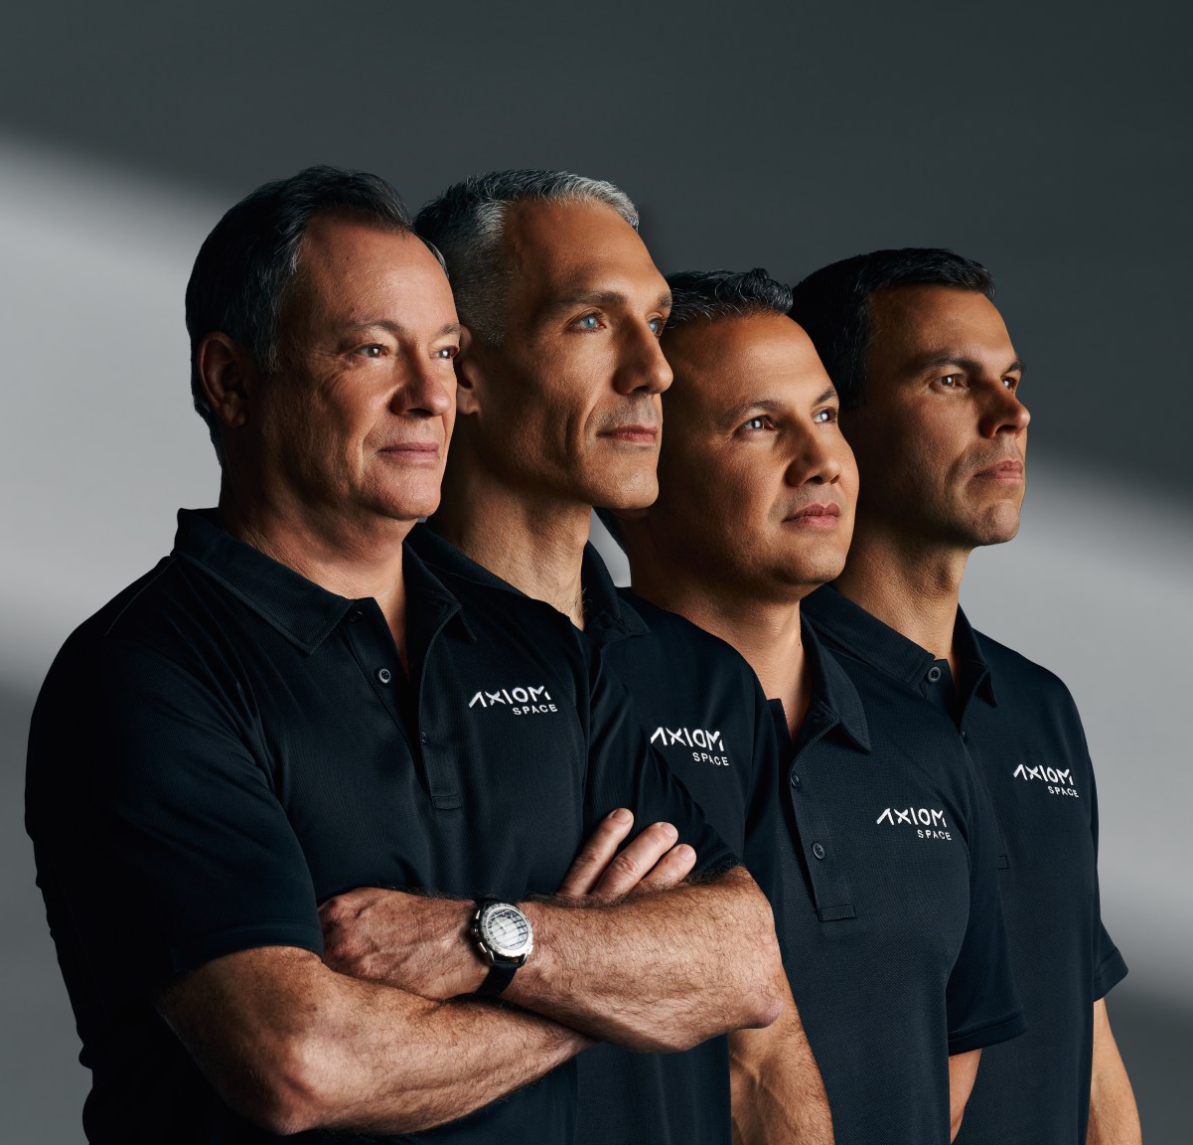
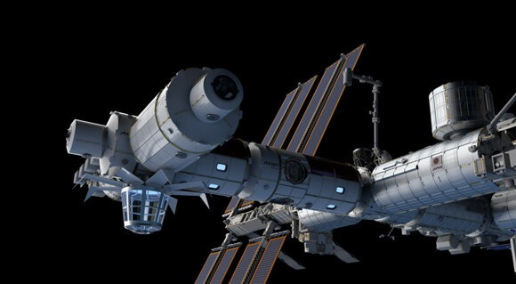
W.Villadei M.L.Alegria
AXIOM space station

Slide 26
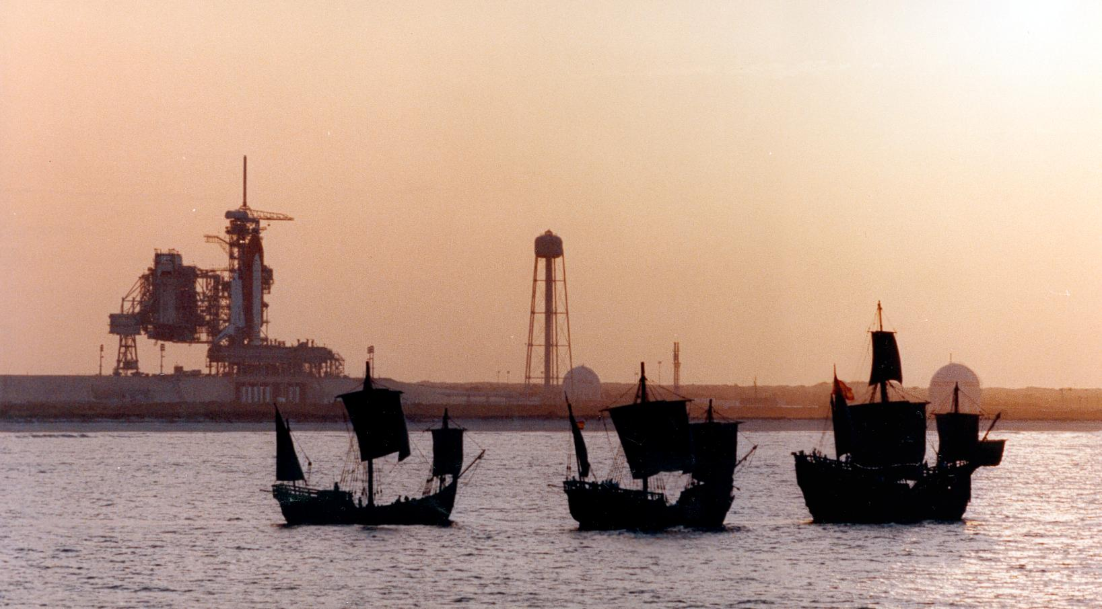
Bravery and technology

